Slide 2

Minor Project 2 Title: Library management System Submitted By: Anish Bansal(R134218020) Kartikey(R134218077)
Nikhil Jain(R134218105) Ankit Gupta ( R134218021) Under the guidance of: Mr. Ankit Vishnoi School of Computer Science and Engineering

Slide 3
ACKNOWLEDGEMENT
The project “Library Management System”, is made by Anish Bansal,Kartikey,Nikhil Jain, Ankit Gupta under the guidance of Ankit Vishnoi. All the progress that has been made till now has been verified by our mentor. The following report has been made so as to submit our progress to the Activity Coordinator.

Slide 4
PURPOSE
The main objective of the Project on Library Management System is to manage the details of Student Books, Issues, Librarian, Member. It manages all the information about Student, Member. The project is totally built at administrative end and thus only the administrator is guaranteed the access. The purpose of the project is to build an application program to reduce the manual work for managing the Student, Books, Issues. It tracks all the details about the Issues, Librarian, Member.

Slide 5
MOTIVATION
The old manual system was suffering from a series of drawbacks. Since whole of the system was to be maintained with hands the process of keeping, maintaining and retrieving the information was very tedious and lengthy. The records were never used to be in a systematic order. there used to be lots of difficulties in associating any particular transaction with a particular context. If any information was to be found it was required to go through the different registers, documents there would never exist anything like report generation.

Slide 6
PROPOSED MODEL
The implementation of this project consists of the following steps:
Create Admin login: Admin is the one who administers the system by adding or removing books into and from the system respectively.
Create User login: Students have to register themselves into the system to create an account. After registering successfully, they can then login into the system.
Create Functionality to Add and Update Books: The admin can add books to the system by entering the details of the books and can even update the details.
Add other features such as -:
View Order-The admin can view order for the books.
Place order- The students can place order for the books and simultaneously the quantity of the book ordered will be decremented.
Calculate Fine- The student can view the issue and expiry date for the book issued and can even calculate fine.

Slide 7
Program Module
Librarian Section:
Find Book: Librarian can find their books with four different categories Name, Category, Type, and Author.
Issued Books: Through this function librarian can check how many books and which books were issued.
Books in stock: It shows the book that is in the stock that means the quantity of the book is more than zero.
All books: It shows all the books in the database.
Add new Book: This is used to add new book in the database.
Edit book details: It is used to edit any book contents.
Remove Book: It allows librarian to delete any book from the database.

Slide 8
Reader Section:
1) Reader register login: Here a new user can register and then login to issue books or an existing user can login with the credentials to issue books.
2) Issue Book: Here the reader can choose the books, not more than 3 books and specify the number of days between 8 to 40 days for which reader wants to issue book. Also, the issue date and the due date is calculated.
3) Find Book: Reader can find their books with four different categories Name, Category, Type, and Author.
4) Issued Books: Through this function, Reader can check how many books and which books were sold.
5) Books in stock: It shows the book that is in the stock that means the quantity of the book is more than zero.
6) Return Book: This function allows the user to return the books and fine alert is also shown.
7) All books: It shows all the books in the database.
8) Logout: This allows the user to logout from the reader section.

Slide 9
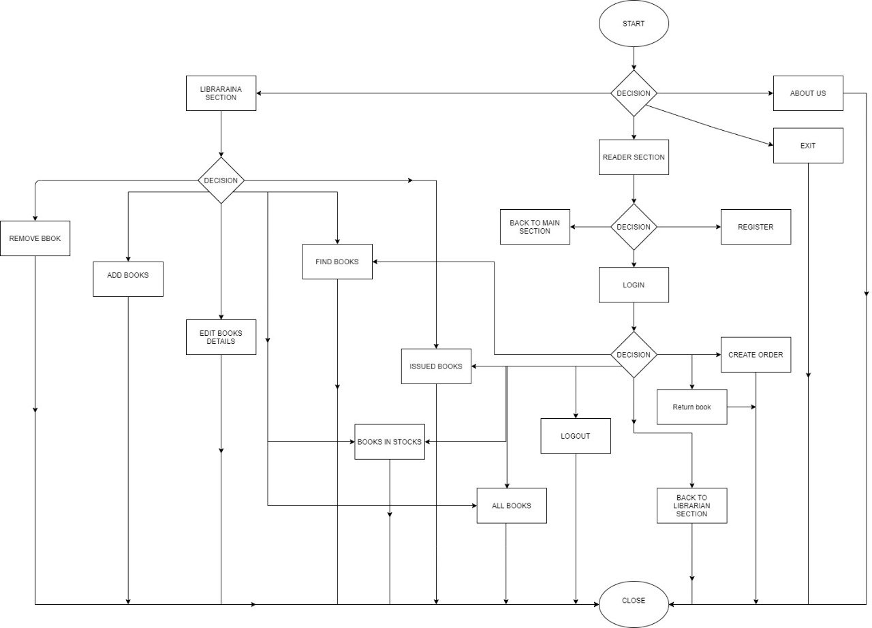
FLOWCHART

Slide 10
ALGORITHM
1. Start
2. Check if user is accessing librarian section or reader section or about us or exit
3. If(librarian)
a. Find Book.
b. Issued Books.
c. Books in Stock.
d. All Books.
e. Add New Book.
f. Edit Book details.
g. Remove Book.
h. Back To Library Main Section.
Else if(reader)
a. Create Order.
b. Find Book.
c. Issued Books.
d. Books in Stock.
e. All Books.
f. Back To Library Main
g. Return Book
h. Logout
Section.
Else if(about us)
Display about us
Else
Exit
4. End

Slide 11
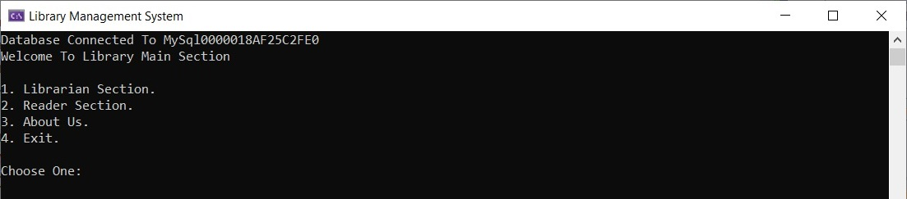
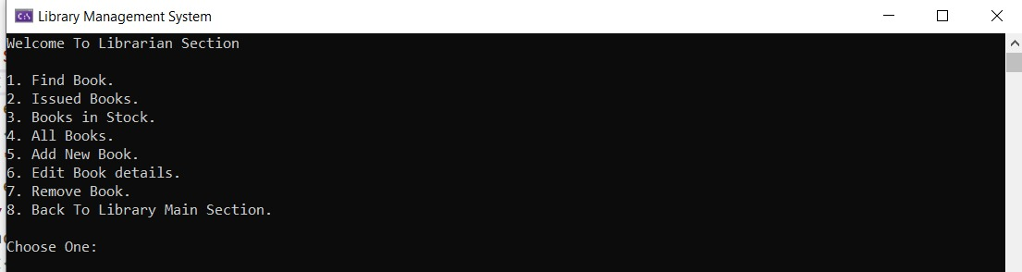
OUTPUT

Slide 12
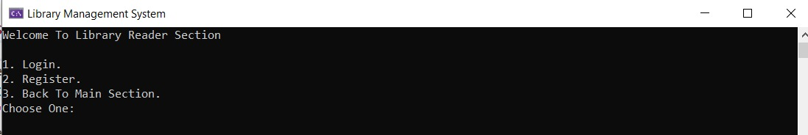
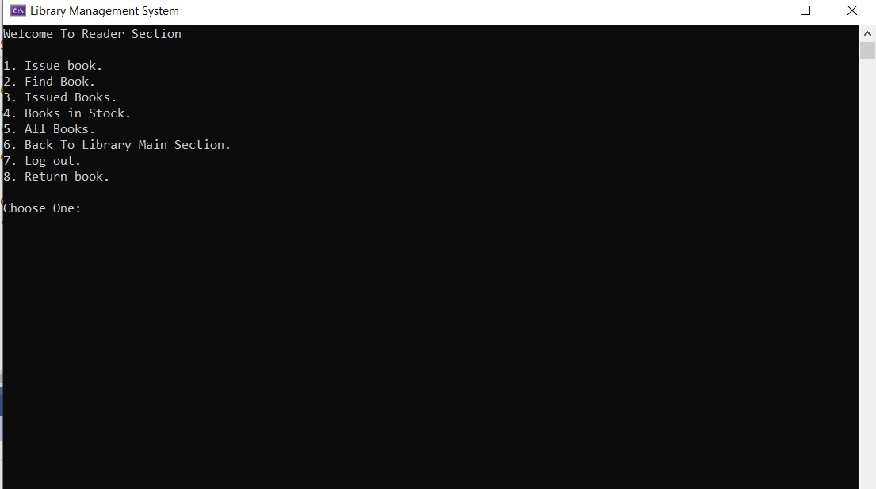

Slide 13
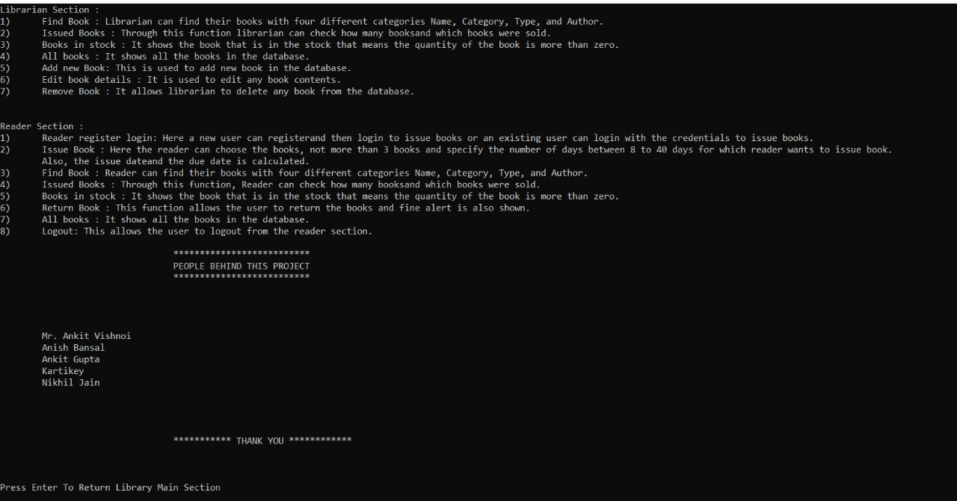

Slide 14
Conclusion
Successfully added different functionalities required in library management system such Searching Books, calculating total cost of books reader has to pay, keeping track of books available in the stock and the books issued.
Also provided other functionalities which librarian can perform such as Adding, Deleting, and editing Books content in the database.
Provided separate interface for the librarian and the reader, which comprises of different functions based upon their requirements.
Designed the system, which saves our time and effort of manual maintenance of records.

Slide 15
REFERENCES
1) https://www.geeksforgeeks.org/sql-using-c-c-and-sqlite/
2) https://press.rebus.community/programmingfundamentals/chapter/file-input-and-output/
3) https://www.geeksforgeeks.org/searching-algorithms/
4) https://www.geeksforgeeks.org/sorting-algorithms/

